Slide 1
SENTIMENT ANALYSIS
Presenting by,
SUPRIYA Y S R20EF437
PRADHUMNA R20EF420
HARSHITHA S R R20EF406
VISHAL R20EF440
Under the guidance of
Prof.Nayana R
Date-12/05/2023

Slide 2
agenda
Abstract
Introduction
Problem Identification
Objectives
Literature Survey
Domain Area
Technology and Domain
Dataset, Tools (Front End and Back End)
Budget
Scope for Publication / Application Development / Patent
Reference

Slide 3
Abstract
A division of natural language processing called sentiment analysis looks for and extracts subjective information from text. It entails analyzing text data to detect the sentiment of the material, whether it is positive, negative, or neutral.
This is done by using machine learning and statistical techniques. Sentiment analysis has several uses, including analyzing customer reviews, forecasting stock market trends, and tracking sentiment on social media. Lexicon-based approaches use lexicons or sentiment dictionaries that have pre-made lists of words and their corresponding polarity in order to assign sentiment ratings to the text.
On the other hand, machine learning-based techniques entail training a model on a labelled dataset to discover the patterns and connections between text and sentiment. To increase the precision of sentiment analysis, hybrid methods incorporate both lexicon-based and machine learning-based techniques.
Numerous industries, including marketing, politics, customer service, and healthcare, use sentiment analysis. Sentiment analysis, for instance, can be used to track social media sentiment and examine consumer reviews to enhance goods and services. It can also be used to forecast election results and analyze political speeches. Sentiment analysis in healthcare can be used to examine patient comments and pinpoint areas where healthcare services need to be improved.

Slide 4
Introduction
Sentiment analysis can be defined as analyzing the positive or negative sentiment of the customer in text. The contextual analysis of identifying information helps businesses understand their customers’ social sentiment by monitoring online conversations.
As customers express their reviews and thoughts about the brand more openly than ever before, sentiment analysis has become a powerful tool to monitor and understand online conversations. Analyzing customer feedback and reviews automatically through survey responses or social media discussions allows you to learn what makes your customer happy or disappointed. Further, you can use this analysis to tailor your products and services to meet your customer’s needs and make your brand successful.
Due to the complexity of natural language and the subjectivity of human emotions, sentiment analysis is a difficult process. In response to the same material, different persons may feel various emotions, and the same emotion may be represented using various words or expressions. As a result, complex methodologies are needed for sentiment analysis in order to capture the subtleties of language and the context in which it is used.

Slide 5
Importance of Sentiment Analysis
The most crucial advantage of sentiment analysis is that it enables you to understand the sentiment of your customers towards your brand. Your products and services can be improved, and you can make more informed decisions by automatically analyzing the customers’ feelings and opinions through social media conversations, reviews, surveys, and more.
According to the survey, 90% of the world’s data is unstructured. Especially in businesses, emails, tickets, chats, social media conversions, and documents are generated daily. Therefore, it is hard to analyze all this vast data in a timely and efficient manner.

Slide 6
How Does Sentiment Analysis Work?
Sentiment analysis works with the help of natural language processing and machine learning algorithms by automatically identifying the customer’s emotions behind the online conversations and feedback.
Depending on the amount of data and accuracy you need in your result, you can implement different sentiment analysis models and algorithms accordingly.

Slide 7
Problem identification
There are quite a few things that companies struggle with in order to obtain sentiment analysis accuracy. Sentiment or emotion analysis can be difficult in natural language processing simply because machines have to be trained to analyze and understand emotions as a human brain does.
This is in addition to understanding the nuances of different languages. As data science continues to evolve, sentiment analysis software is able to tackle these issues better.
Due to the subjective character of human emotions and the complexity of natural language, sentiment analysis is a difficult undertaking. To increase the precision and dependability of sentiment analysis, a number of issues must be solved.

Slide 8
objectives
By using sentimental analysis, we will get to know about the product. Sentiments like reviews, emojis, rating and also by uploading the product picture.
This prediction helps the platform to know about the productivity of particular product.
To study about the customers satisfaction of online shopping.
This sentimental analysis helps to know which product category has lower review or may be inferior product.
Detects the emotion of the customers regarding products, services, or the brand.

Slide 9
Literature review
Overview of the review done.
SNo | Author Name, Publisher, Journal Name, Year | Title of the Paper | Data set & Environment setup | Objectives | Current Study (Algorithm/ Methodology) | Accuracy / Performance (Result Analysis) | Gap Analysis
1 | M. KavithaM. Kavitha; Bharat Bhushan Naib; Basetty Mallikarjuna; R. Kavitha; R. Srinivasan | Sentiment Analysis using NLP and Machine Learning Techniques on Social Media Data | Social media dataset. | Predicting the customer’s reviews. | Random Forest Classifier, Decision Tree Classifier, and Logistic Regression algorithms | 3 ratings of usage out of 5. | Accuracy and F-Score
2 | M S Neethu; R Rajasree | Sentiment analysis in twitter using machine learning techniques | Twitter dataset | classifying the tweets as positive, negative | Sentiment Reasoner, Machine Learning, Naive Bayes, K-Nearest Neighbors | 90.00% | 20%
3 | Rajkumar S. Jagdale, Vishal S. Shirsat and Sachin N. Deshmukh | Sentiment Analysis on Product Reviews Using Machine Learning Techniques | Social media data | classifying the Products Reviews | Preprocessing, tokenization | 98.17% | 10.2%
4 | Jayakumar Sadhasivam,Ramesh -Babu Kalivaradhan | Sentiment Analysis of Amazon Products Using Ensemble Machine Learning Algorithm | Amazon review and replied dataset | Users deciding to get the product or not. | Processing Proposed Modules, Classification Module, Naive Bayes Algorithm | Not specified | 23.2%

Slide 10
Literature review for Application
Overview of the review done.
SNo | Developer Name, Available in platform (Google play/ Microsoft store/ Apple store etc) Year and | Application Name, No of downloads, (Using company name) if any | Data set & Software and Hard ware specification | Objectives | Current Technology / domain / algorithms | Accuracy / Performance (Result Analysis)
1 | Jupyter notebook | Fernando Pérez | 512MB RAM + 1GB of disk | create and share documents that contain live code, equations, visualizations, and narrative text | SVM | 93.94%

Slide 11
Domain Area
1.Technology :
Using Python programming to implement Sentiment analysis.
An Natural Language Processing (NLP) is the machine learning technology that determines data’s positivity, negativity, or neutrality is sentiment analysis. It gives computers the ability to define the data and automatically manipulate natural language, like speech and text approach of Sentiment Analysis.
2.Dataset, Tools:
We are using product review dataset, according to that we are find the accuracy value of prediction of customer’s reviews.
Tools : Jupyter notebook

Slide 12
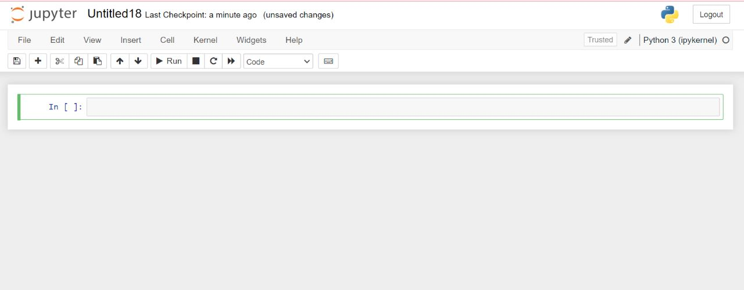
The below image represents jupyter notebook platform on which we are going to perform prediction operations using python.

Slide 13
RESULT outcome and snapshots:
Improve the accuracy of sentiment analysis models: This can be achieved with advanced machine learning algorithms and neural networks that can better capture the nuances of language and context.
Accounting for the influence of product attributes: Certain product attributes, such as price or quality, can significantly impact the sentiment expressed in a review. Therefore, incorporating product attribute analysis into sentiment analysis can help to improve accuracy.

Slide 14
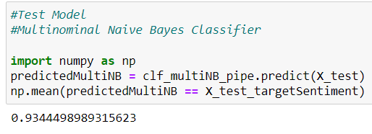
Fig.1. Finding Accuracy Using Naïve Bayes Classifier

Slide 15
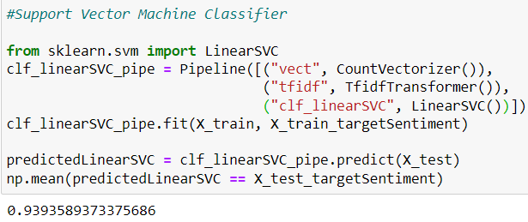
Fig.2. Finding Accuracy Using Support Vector Machine Classifier

Slide 16
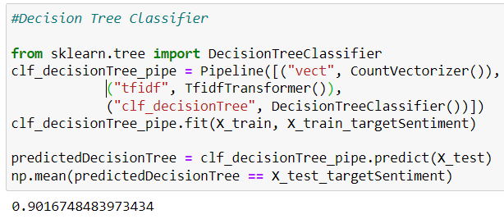
Fig.3. Finding Accuracy Using Decision Tree Classifier

Slide 17
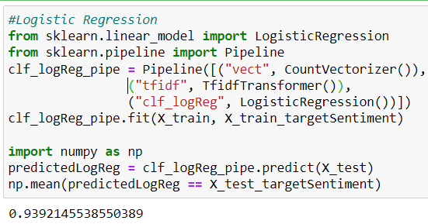
Fig.4. Finding Accuracy Using Logistic Regression

Slide 18
By Observing above accuracy of predictions such as Multinominal Naive Bayes Classifier , Support Vector Machine Classifier, Decision Tree Classifier and Logistic Regression we can conclude that among all those prediction models Support Vector Machine giving the highest accuracy.
So by using Support Vector Machine Algorithm we will get the maximum accuracy of predicting the Reviews.

Slide 19
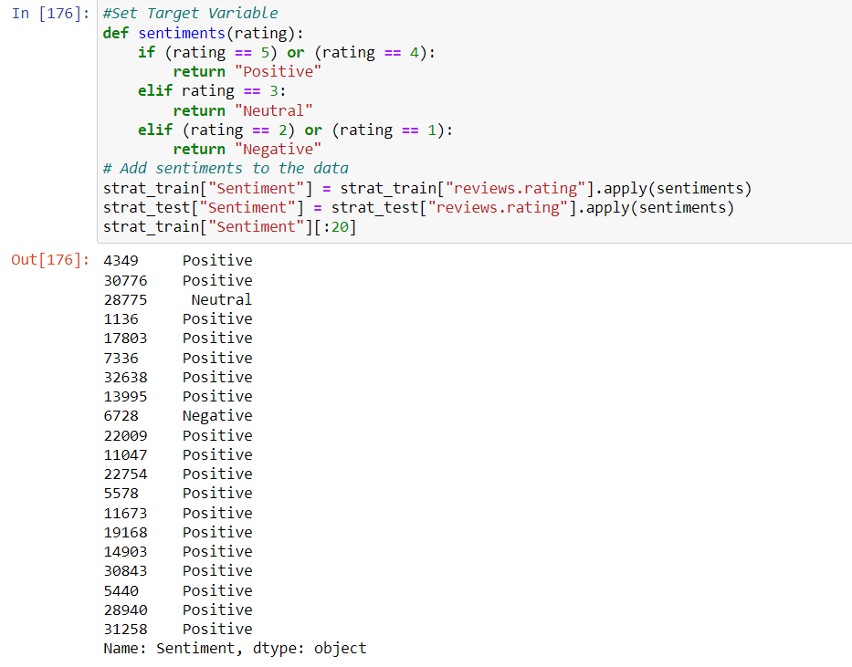
Fig.5. Setting Target Variables for Ratings to know either a rating is Positive, Negative or Neutral.

Slide 20
Scope for Publication
The scope of publications using sentiment analysis on customer evaluations is enormous and expanding quickly. Sentiment analysis is the method of figuring out if a piece of text, such a review of a product, is good, negative, or neutral by automatically analysing and determining its sentiment.
Businesses may learn from client comments, spot areas for development, and create better goods and services by using sentiment analysis on product evaluations. By offering consumers an unbiased study of product reviews, it may also assist them in making better educated purchasing decisions.
The results of sentiment analysis on product reviews can be published in various forms, including academic papers, industry reports, and online reviews. They can also be used by businesses to inform marketing strategies, improve customer service, and enhance brand reputation.

Slide 21
Conclusion :
In conclusion, sentiment analysis on product reviews is an important area of exploration with significant implicit operations for businesses and associations. still, it presents unique challenges that bear specific results, similar as the objectification of sphere-specific sentiment dictionaries, counting for the influence of product attributes, using stoner demographics, addressing fake reviews, developing ways for relative sentiment analysis, and incorporating visual analysis. By addressing these challenges and incorporating these results, sentiment analysis on product reviews can give more accurate and practicable perceptivity, helping companies and associations make data- driven opinions to ameliorate their products and services. As similar, sentiment analysis on product reviews represents an instigative area of exploration with significant eventuality for unborn advancements and operations.

Slide 22
References
Sentiment Analysis using NLP and Machine Learning Techniques on Social Media Data ,published in 2022 2nd International Conference on Advance Computing and Innovative Technologies in Engineering (ICACITE),Published by M. Kavitha,Bharat Bhushan Naib,Basetty Mallikarjuna,R. Kavitha; R. Srinivasan.
Sentiment analysis in twitter using machine learning techniques , published in 2013 Fourth International Conference on Computing, Communications and Networking Technologies (ICCCNT), published by, M S Neethu and R Rajasree.
Sentiment Analysis on Product Reviews Using Machine Learning Techniques ,published in 2019, published by, Rajkumar S. Jagdale, Vishal S. Shirsat and Sachin N. Deshmukh.
Sentiment Analysis of Amazon Products Using Ensemble Machine Learning Algorithm ,published in February 5, 2019 , published by Jayakumar Sadhasivam and Ramesh Babu Kalivaradhan.
Dataset Source: Kaggle https://www.kaggle.com/

